Slide 1
Hematology Case Studies
Rhonda Hewitt, MSN, ANP, AOCNP
Hematology APP IV
Stanford Health Care

Slide 2
Case Study #1
CB is a 70 year old female with PMH papillary thyroid carcinoma s/p total thyroidectomy (2012) and Radioiodine Ablation who presents with a recent diagnosis of IgG lambda multiple myeloma
Comes to the ITA for C1D1 Daratumumab-Velcade-Dexamethasone
Vitals: BP 145/71, HR 64, Resp 17, Temp 36.5, O2 97% RA
Exam: Unremarkable with the exception of lower back pain and right hip pain. Denies n/v/d/c. States she is drinking around 1L/day
Labs:
WBC 5.7, HGB 12.4, HCT 37.6, PLTS 267, ANC 3.32
Na 123, K 5.0, Cl 93, Cr 0.77, Ca 7.9, T-bili 0.4, Total Protein 10.6, Globulin 7.0, Glucose 77

Slide 3
Hyponatremia Definition
Excess of body water in relation to sodium content
Serum sodium less than 135 mEq/L
Usually caused by a failure to excrete water normally
In healthy individuals, the ingestion of water does not lead to hyponatremia because suppressed release of antidiuretic hormone (ADH), also called vasopressin, allows excess water to be excreted in a dilute urine
Many people will have one clear reason for hyponatremia but cancer patients often have more than one contributing factor
Volume depletion (poor po intake, vomiting, diarrhea), infection, SIADH (r/t disease or therapies), adrenal insufficiency, etc

Slide 4
Sodium
Total body sodium is primarily extracellular
Sodium wants to hold on to water
Increases in sodium causes increase in tonicity
Increases in tonicity signals the thirst center in the posterior pituitary
Arginine Vasopressin is released (ADH)
V2 receptors in the renal tubules increase water reabsorption and vasoconstriction

Slide 5
Osmolality
Measured by the number of solute particles in 1kg of plasma
Normal serum osmolality is 280-295 mOsm/kg
Hyponatremia results from changes in total body water, not necessarily total body sodium

Slide 6
Physical Exam
Focus on assessment of volume status as this is a key step in determining the cause of hyponatremia
Causes are divided on the patient’s volume status and the serum osmolality
Pseudohyponatremia
Dilutional hyponatremia
Hypovolemic hyponatremia
Euvolemic hyponatremia
Hypervolemic hyponatremia

Slide 7
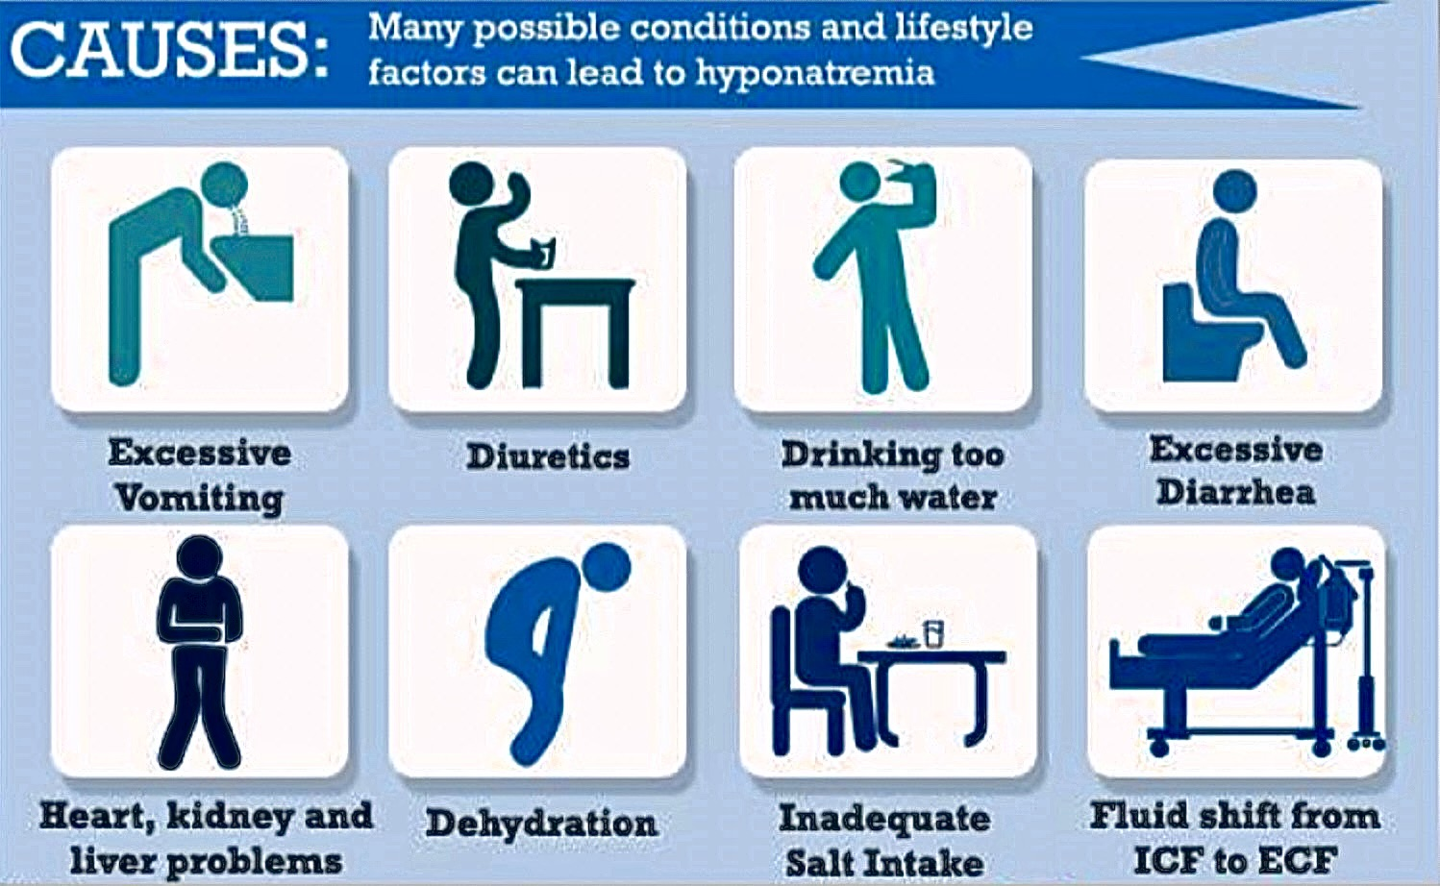
Typical Causes
Image from http://www.nursingguide.ph/userfiles/hyponatremia_final.jpg

Slide 8
Symptoms
May be asymptomatic
Symptoms are more likely with a serum Na <120 or with a rapid change
CNS symptoms, such as confusion, lethargy, seizure, and coma, are most common

Slide 9
Hyponatremia…where to start?
Low Serum Sodium
(<135 mEq/L)
Hyperglycemia present?
No
Yes
Calculate corrected serum sodium
Could extra solutes be present in the serum:
1. Is the patient post-op after prostate or uterine surgery.
2. Has the patient received IV mannitol or IVIG
Is there a reason to suspect pseudohyponatremia (due to hyperlipidemia or hyperproteinemia):
Is the serum lipemic?
Is the patient jaundiced?
Is there a history of plasma cell dyscrasia?

Slide 10
What is pseudohyponatremia?
Typically caused by hyperlipidemia or hyperproteinemia
Patients with multiple myeloma can have severe hyperproteinemia (usually greater than 10 g/dL)
Serum is mostly made up of water (97%) and solids such as fats and proteins (7%)
Both hyperlipidemia and hyperproteinemia reduce the water content of a given volume of plasma.
Sodium concentration in the water phase is not affected but the sodium concentration per unit of plasma is reduced → looks like the sodium is low when it actually is not.
To check for pseudohyponatremia the lab will need to check the sodium using direct-ion selective electrode which directly measures the concentration in the water phase of plasma.

Slide 11
Case Study #1
123 mmol/L
Serum Sodium level
10.6 g/dL
Multiple Myeloma (new diagnosis)
135 mmol/L
Retested sodium using direct ion-selective electrode
Elevated Total Protein Level
Asymptomatic

Slide 12
Case Study #2
DL is a 76F with h/o COPD and CLL. Came to the ITA today for evaluation of acute on chronic SOB along with fever, cough and fatigue.
DL says she has been dealing with PNA for months. For the last six months she has been to her PCP for c/o dyspnea & cough. Endorses smoking and knows she should stop but it is hard after 50 years.
PCP prescribed multiple short courses of medications for her but she is not sure the names. The coughing improved for a while but the dyspnea never fully recovered.
What are you starting to think about as you are learning about this patient?

Slide 13
Case Study #2
Two days ago the coughing started up again and she had a fever today for the first time.
Denies n/v, HA, confusion, muscle cramps, seizures.
Vitals: 122/80, no orthostatic HoTN. HR 80’s. 38.5C, 94% RA
PE: MMM, Expiratory wheezing, no crackles, normal HR, +BS, no edema
What are some of the diagnostic studies you anticipate will be ordered?

Slide 14
Workup
Chest x-ray concerning for pneumonia
Blood work:
WBC 11.5, HGB 13.4, PLTS 250
Na 129, K 4.3, Cl 106, Cr 1.02, Ca 9.0, T-bili 0.7, Glucose 90
What other lab work would you like to order?
Serum Osmols: 267 mOsm/Kg (L)
Urine Osmols: 566 mOsm/Kg (H)
Urine Sodium: 80 mmol/L (H)
Sepsis/fever w/u

Slide 15
Hypotonic Hyponatremia (too much water)… why?
No use of thiazide diuretics, edema or hypovolemia
Urine Osmol >100
Measure urine osmols/sodium
Urine Sodium >40
Glucocorticoid deficiency
SIADH
Hypothyroid

Slide 16
Case Study #2
Glucocorticoid Deficiency
Patient has been on multiple “rounds of medications” and feels tired and weak. Possible she has been on prednisone and/or on steroid inhalers
Adrenal function can be suppressed with 7.5mg prednisolone x3 weeks.
Consider AM cortisol and ACTH stimulation test
If low, treat with high dose prednisone
Hypothyroidism
Check TSH
If low treat with hormone replacement
SIADH
Associated with several cancers, medications, CNS causes and pulmonary diseases
Initial treatment includes fluid restriction and workup of underlying cause

Slide 17
Case #3
YZ is a 44yo woman with relapsed AML dx in 2013 s/p relapse in 2014, s/p myeloablative double umbilical cord transplant (2015) c/b fulminant liver failure after reactivation of hepatitis B s/p liver transplant in 2018, CKD, penicillin allergy, and now relapsed AML (Sep 2023) currently on Decitabine/Ven recently admitted to the ITA for labs, IV hydration, & possible transfusion but her husband calls from the parking lot to cancel her appt bc she feels poorly & just wants to go home to rest
What is your first response?

Slide 18
Case #3
Last seen by your colleague in ITA 2 days ago when she presented for her ambisome therapy. At that time her Cr was elevated
ambisome held (QMWF)
2L NS IVF given
Pt to push po fluids

Slide 19
Case #3
- since hospital discharge pt has progressive fatigue & worsening dry cough
- last night she had some mild shaking chills which resolved spontaneously
- no fevers
- she is drinking 4L of water daily; only water, no other fluids
- not able to eat as it causes a burning sensation in her stomach
- no appetite but no n/v
- no known sick contacts
- normal bowels
- no skin lesions
- no other localizing s&s of infection
- no other complaints

Slide 20
Case #3
Visit Vitals
BP | 122/82 | Comment: standard adult size BP cuff.
Pulse | 82
Temp | 36.8 °C (98.2 °F) (Oral)
Resp | 18
Wt | 51.4 kg (113 lb 5.1 oz) | Comment: without shoes.
SpO2 | 100%
BMI | 18.88 kg/m²
Gen: petite woman sitting in bed in NAD. She has a frequent dry cough. No work of breathing & doesn't appear SOB but clearly struggling not to have coughing episode (triggered by deep breaths & talking)
HEENT: mild erythema posterior pharynx, no lesions or exudate
Chest: CTAB
CV RRR
ABD: benign
EXT no edema
Neuro: nonfocal

Slide 21
Case #3
What are you worried about?

Slide 22
Case #3
Na 122
K 3.1
Cr 1.89 (down from 2.1 2 days ago)
Lactate 0.8
WBC 0.9, ANC 220
Urine osm 93 mosmol/kg (L)
Urine Na 22 mEq/L (L)

Slide 23
Case #3
Patient’s hyponatremia is likely multifactorial including too much free water intake as well as an untreated pulmonary process
She was admitted to SHC for water intoxication & Na was corrected with free water restriction & hypertonic saline

Slide 24
Summary
Hyponatremia is common in the oncology setting
Poor po intake &/or fluid losses are frequent contributing factors but are often not the only potential contributors
The diagnostic approach to hyponatremia begins with a thorough knowledge of the patient & treatment but the physical exam is critical to accurate diagnosis & management
Consider asking for an “APP evaluation” for any hyponatremic patient who has not already had an in-person appointment if the cause for hyponatremia isn’t obvious &/or if the pt is symptomatic

Slide 25
Case #4
Kyle is a 22 yo male with ALL
C1D9 Remission Consolidation per Alliance protocol
2 days of sore throat
Brought into ED by parents who found him on the floor, unarousable
Exam:
Looks ill
Drowsy, incoherent
Cold peripheries
T36C, pulse thready at 141, BP 74/42, RR24, O2 90%
Grade 2 mucositis, chest CTAB, abdomen benign
PICC site without erythema

Slide 26
Case #4
What are you most concerned about?
1. neutropenic fever/sepsis
2. pulmonary embolism
3. overdose
Notes:
2. NF/sepsis

Slide 27
Neutropenic Fever
Up to 80% of hematology patients will have NF at least once⁶
10-50% in solid tumor patients⁶
Likelihood of fever increases with duration & severity of neutropenia as well as the rate of decline in the ANC
Most therapies associated with a count nadir at 7-10 days
6. Rosenberg PS, Alter BP, Bolyard AA, et al. The incidence of leukemia and mortality from sepsis in patients with severe congenital neutropenia receiving long-term G-CSF therapy. Blood. 2006;107(12):4628–35

Slide 28
Neutropenic Fever
Only find a source in 20-35% of cases
Fever might be d/t underlying disease (eg leukemia), mucositis, toxicity of therapy, or other
If bacterial source, it is most likely to be endogenous ie bacteria that normally lives somewhere got somewhere it is not supposed to be
Gut, respiratory tract, skin are common sources
Also consider GU & line associated sources
Rosenberg PS, Alter BP, Bolyard AA, et al. The incidence of leukemia and mortality from sepsis in patients with severe congenital neutropenia receiving long-term G-CSF therapy. Blood. 2006;107(12):4628–35

Slide 29
Neutropenic Fever
Fever:
A single oral temp > or = 38.3C without signs of noninfectious causes of increased temperature
Or a temp of > or = 38C sustained for 60 min in a patient with ANC <500
Neutropenia:
Mild neutropenia ANC 1000-1500
Moderate Neutropenia ANC 500-999
Severe Neutropenia ANC 100-499
Profound Neutropenia ANC < 100

Slide 30
Neutropenic Fever
Physical exam
Drowsy, decreased LOC, confusion
Ill appearing
Cold peripheries
Localizing symptoms → skin lesion, mucositis, uri sx, cough, belly pain, dysuria, diarrhea or constipation, etc
VS → not always febrile!
Hypotensive
Tachycardic
Tachypneic

Slide 31
Neutropenic Fever
Panculture (blood, urine, COVID)
CBCD
CMP
Lactate
Coags
Localizing symptoms? → skin, sputum, stool, resp DFA, imaging such as abdominal u/s vs CT
If respiratory symptoms → CXR
May be clear d/t lack of inflammatory response

Slide 32
Neutropenic Fever – Assess Risk Level
High risk patients are those with any of the following:
Anticipated, prolonged (>7 days) & profound neutropenia
Clinically unstable
Significant medical comorbidities including hypotension, pneumonia, new-onset abdominal pain, or neurologic changes
Sometimes this is your gut feeling eg “patient looks toxic”

Slide 33
Neutropenic Fever – Assess Risk Level
Low risk patients are those with any of the following:
Brief duration of neutropenia (< 7 days)
ANC > 100
Normal CXR
Outpatient status at fever onset
No associated acute comorbid illness
No hepatic or renal insufficiency
Early evidence of bone marrow recovery

Slide 34
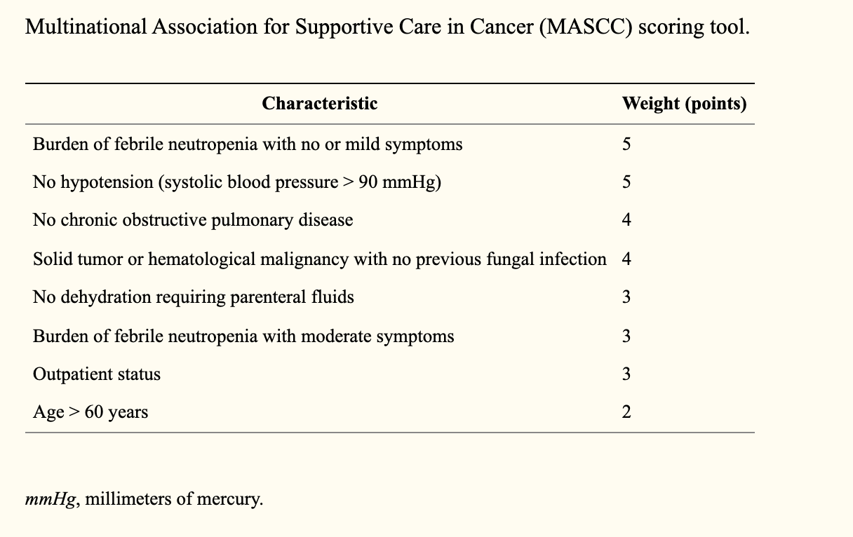
Neutropenic Fever – Assess Risk Level
A high MASCC score is associated with better prognosis

Slide 35
Neutropenic Fever – Assess Risk Level
Historically most NF patients were always admitted to the hospital but this isn’t always the case
Patient preferences/life expectancy eg older AML patients on HMA + Ven
Increased risk of nosocomial infections for NF pts
No beds in the hospital
ITA open 7 days/wk 7am-9pm
Ability to give IV antibx, antivirals, antifungals in outpt setting

Slide 36
Neutropenic Fever – Assess Risk Level
In general:
High risk patients should be admitted to the hospital for empiric therapy & close observation
Low risk patients may be candidates for oral empiric therapy & may be managed in the outpatient setting with close follow up
You are almost never wrong if you err on the side of caution

Slide 37
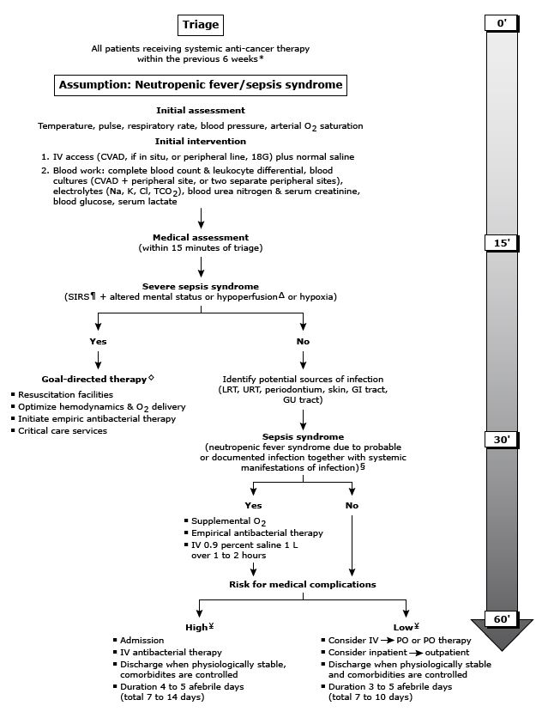
Time-dependent algorithm for the initial assessment & management of cancer patients with neutropenic fever & suspected sepsis syndrome
Uptodate.com

Slide 38
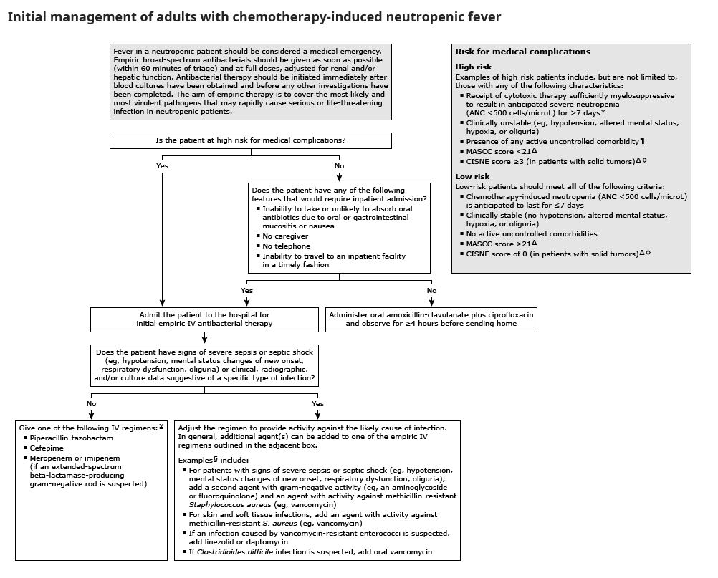

Slide 39
Case #5
KS is a 57yo woman with RRMM diagnosed 4yrs ago & treated with multiple lines of therapy. Most recently treated with carfilzomib which required multiple dose reductions d/t ae’s (thrombocytopenia & HTN) & ultimately discontinued (~2mo ago) d/t presyncopal episodes & poor myeloma control intake &/or fluid losses are frequent contributing factors but are often not the only potential contributors
6 months ago she had pain in her left upper arm & MRI revealed a solitary lytic lesion but no fracture → treated with palliative local radiation & switch in MM regimen
She presents to the ITA with increased pain

Slide 40
Case #5
KS complains that, although although her left arm pain was temporarily better following radiation, over the past couple of weeks her pain has increased 6 months ago she had pain in her left upper arm & MRI revealed a solitary lytic lesion but no fracture → treated with palliative local radiation & switch in MM regimen
She is also having some pain in her right arm which she attributes to “muscle strain” because she “has been using her right arm for everything because the left hurts”

Slide 41
Case #5
ROS + for fatigue, feeling mentally slow, dry mouth, lack of appetite, mild nausea, constipation all of which she attributes to the MS Contin she has been using for the past 5 months
Very thirsty & urinating frequently → she asks if she might have diabetes
Based on KS’s complaints & her ROS what are you most concerned about?
1. diabetes
2. opiate over use
3. hypercalcemia
4. Pulled/strained muscle

Slide 42
Hypercalcemia
Most common metabolic complication of cancer
It is a poor prognostic factor (>50% die within 30 days of dx of hypercalcemia)
20-30 % of all cancer patients per year will be diagnosed with hypercalcemia at some point during their disease course
BLT with Kosher Pickle & Mayo
Breast (70%), Lung (35%), Thyroid (10%), Kidney (30%), Prostate (80%), Myeloma (>40%)
Often life-threatening hypercalcemia
UpToDate. Stewart AF. N Engl J Med 2005;352:373-9

Slide 43
Hypercalcemia
Stones, bones, abdominal moans, & psychic overtones
CNS → fatigue, weakness, lethargy, apathy, seizures, coma, depression, stupor, confusion, restlessness, hyporeflexia, visual disturbances
Bone pain → pathologic fracture
GU → polydipsia, polyuria, nocturia, calcium nephropathy, hypercalciuria, nephrolithiasis
Gastrointestinal → dehydration, anorexia, N/V, constipation, abdominal pains
CV → HTN, bradycardia, arrhythmias, cardiac arrest, heart block, digitalis sensitivity, shortened QT
UpToDate

Slide 44
Hypercalcemia
Corrected Serum Calcium Level | Degree of Hypercalcemia
8.5-10.5 mg/dl | Normal
10.5-12.0 mg/dl | Mild
12.0-13.5 mg/dl | Moderate
>13.5 mg/dl | Severe
UpToDate

Slide 45
Hypercalcemia: Treatment
Mild hypercalcemia
Patients are often asymptomatic
Therapy includes:
Activity → they should not become inactive!
Avoid salt restriction
Discontinue thiazide diuretics
Stop calcium rich antacids
Increase oral fluids
Quit smoking
Treat underlying disease
UpToDate

Slide 46
Hypercalcemia: Treatment
Moderate to Severe hypercalcemia
Hydration, hydration, hydration → patients are dehydrated d/t polyuria & renal tubular dysfunction
Diuretics → furosemide (unproven but common practice)
Discontinue thiazide diuretics
Antiresorptive therapy
Bisphosphonates to inhibit osteoclasts → zoledronic acid, pamidronate
Denosumab → binds to RANKL to block osteoclast maturation, function, & survival
Calcitonin (usu given with bisphosphonates)
Treat underlying disease
UpToDate

Slide 47
Case #6
JN is a 20yo male with B-cell Acute lymphocytic leukemia C1D12 alliance course II remission consolidation
Had a transient episode of RUE numbness while eating dinner last night
When he woke this morning BUEs were numb (still able to move them)
On his way to the ITA he had acute change in his ability to talk → could only speak in whisper
Mom calls ITA & you direct her to take him to the nearest ED (SHC). You call ED to alert them

Slide 48
Neurotoxicity
Common with ALL
Disease & the therapy
New treatment modalities associated with unique neurotoxicities
CAR-T
Blinatumomab
Complete pathophysiology of neurotoxicity remains unclear but is thought to be d/t vascular instability with increased blood–brain barrier permeability leading to elevated concentrations of cytokines in the CSF
Gust, J, et al. Endothelial activation and blood–brain barrier disruption in neurotoxicity after adoptive immunotherapy with CD19 CAR-T cells. Cancer Discov. 2017;7(12):1404–1419

Slide 49
Case #7
PT is a 27yo woman with relapsed ALL C1D5 blinatumomab who presents to the ED with aphasia & T40.3C
ROS +fatigue, drowsiness, HA, tremor, speech not understandable for past 2hrs
T40.3C, 98/68, 130bpm, RR26, O2 sat 93%

Slide 50
Case #7
What are you most concerned about?
1. sepsis
2. cytokine release syndrome
3. pulmonary embolism
4. heart failure

Slide 51
Cytokine Release Syndrome
CRS is an acute systemic inflammatory syndrome characterizes by fever & multiple organ dysfunction that is most often caused by immunotherapy
CAR-T, bispecific antibody therapy, haplo HCT, other immune therapy
Onset variable but typically early in course
Clinical manifestations range from mild, flu-like symptoms to severe life-threatening systemic inflammatory response syndrome
Treatment depends on cause
Stop infusion
Involve primary team

Slide 52
Case #8
50 yo woman with newly diagnosed AML. WBC 88K with 78% blasts and platelets of 3K. Electrolytes are OK
She reports profound fatigue. She received a unit of PRBCs for hemoglobin of 7 and developed dyspnea.
O2 sat 80%, RR34 with temp 38.2◦C.
What are you concerned about?

Slide 53
Hyperleukocytosis (HL)
Present in ~5 to 20% of untreated AML
Commonly defined as WBC >100K but can occur below arbitrary threshold
Association with monocytic AML subtypes
Chromosomal MLL rearrangements
FLT3-ITD mutations

Slide 54
Hyperleukocytosis (HL)
Present in ~5 to 20% of untreated AML
Commonly defined as WBC >100K but can occur below arbitrary threshold
Association with monocytic AML subtypes
Chromosomal MLL rearrangements
FLT3-ITD mutations

Slide 55
Case #9
A 35-year-old man with AML is treated with induction therapy. On day 16, he develops fevers, bloody diarrhea, and right lower abdominal pain followed a few hours later by an acute abdomen. He undergoes emergency explorative laparotomy and right hemicolectomy with temporary colostomy.

Slide 56
Neutropenic enterocolitis (NE)
AKA necrotizing colitis, ileocecal syndrome or typhlitis
Ill defined syndrome characterized by fever and abdominal pain in setting of neutropenia
Bacteremia common
Reported incidence ~6.5%

Slide 57
Neutropenic enterocolitis (NE)
Pathogenesis linked to damaged GI mucosa from chemotherapy and neutropenia
CT findings with thickening of bowel wall and intramural edema +/- paracolonic fluid, free air or pneumatosis intestinalis
Greater than 10-mm wall thickening linked to 60% mortality
Treatment includes bowel rest, fluid resuscitation, NG suction, parenteral nutrition and broad spectrum antibiotics.

Slide 58
Summary
Nurses play a huge role in the care of the hematology patient
These patients can be sick - sometimes obviously & other times more subtly
Newer therapies which have unique toxicities, more complex care, older patient populations all potentially increase the acuity & the needs of our patients

Slide 59
Questions…

