Slide 1
Hot Topics In Oncology Care Conference:
Have a great sex life after cancer
June 15, 2024
By
Bryna Barsky, Ph.D.

Slide 2
Dr. Bryna Barsky
**Private Practice
Day and evening hours available
Monday through Friday
(510) 913-4588
E-mail: brynabx@yahoo.com
CAN ALSO LOOK ME UP ON PSYCHOLOGY TODAY.COM
UNDER “FIND A THERAPIST”

Slide 3
How Does Cancer and Its Treatment Affect Sexuality Psychologically/Physically (surgery, chemotherapy, radiation)
Sex Dysfunction in both men and women
ED due to nerve damage, pain, numbness, anti-androgens
Anorgasmia
Pain: due to decreased lubrication/genital swelling, reduction vaginal length/elasticity, scar tissue in urethra/pelvis causing pain with ejaculation/erection, curve/bend in erection
Low Desire: nausea/vomiting, fatigue, pain, bleeding

Slide 4
Radiation therapy, Cryosurgery, and Radical prostatectomy
Radiation Therapy
may cause problems slowly and over time
ED due to damage to blood vessels providing blood to the penis
Radical prostatectomy
ED caused by injuring/removing nerve bundles (either side of the prostate) that send messages to penis to initiate erections. Even if not injured can still have ED.
veins in penis may suffer trauma during surgery, unable to keep blood trapped inside
Cryosurgery
when prostate gland is frozen, nerve bundles can be permanently damaged
Notes:
4

Slide 5
Duration of ED and Orgasmic Dysfunction following surgery
Erections
body takes time to recover
ability to have erection will improve over time
3-12 months after surgery
most will not be able to get a spontaneous erection
will need to use medications or other treatments
Orgasms: dry orgasms (no ejaculation)
2 structures responsible for most fluid in semen – prostate/seminal vesicles – have been removed
lack of ejaculation: doesn’t have to interfere w/desire, arousal, orgasm
Notes:
5

Slide 6
Lack of Estrogen/Testosterone Changes Sexuality
Longer time to get aroused, decrease in desire
Fewer orgasmic contractions, aren’t as intense
Painful intercourse due to vaginal dryness, thinning of vaginal walls, vaginal shrinkage, reduction in tissue elasticity
The clitoris can become too sensitive/numb
Uterine contractions during orgasm/arousal can be painful
Lack of Testosterone can impair desire, arousal and orgasm in men/women
Is supplementation with topical estrogen or testosterone safe? Pros and cons discussed

Slide 7
Sex Therapy
Purpose
Resolve sexual dysfunction
Increase sexual repertoire
Enhance the sexual relationship
Increase comfort with giving and receiving pleasure
Increase emotional, physical and sexual intimacy
Work around medication and medically induced limitations
How it is accomplished?
Identify & examine feelings and cognitions
Skill building: problem solving, communication
Homework
Sexual Script modification
Build individual/couple’s strengths
Sex education
Increase items in your sex basket

Slide 8
ConductING a Sex Intake
Use the language that the client uses
Be specific and concrete
Avoid medical terms, use layperson terms
Make good eye contact if client is willing
Give exs of questions/concerns other clients have raised
Reassure: no question is stupid, all concerns are valid/important
Try to not be so serious
Offer encouragement to discuss sexual issues
Clients will probably be uncomfortable talking with you about sex
Clients probably haven’t been totally honest or open with their partners about the depth and breath of the sexual problem
Don’t Assume:
sexual activity or celibacy
knowledge of anatomy, heterosexuality
Don’t impose your sexual values onto the client
Copyright © 2024, by Dr. Bryna Barsky

Slide 9
DSM-5
DSM-5 has gender-specific sexual dysfunctions.
For females: desire and arousal disorders combined into female sexual interest/arousal disorder
DSM-5 sex dysfunctions (except substance-/medication-induced sex dysfunction) require duration of 6 months and more exact severity criteria
New in DSM-5 is genito-pelvic pain/penetration disorder (combines vaginismus and dyspareunia from DSM-IV)
Sexual aversion disorder was deleted
DSM-5 subtypes for all disorders includes only "lifelong vs. acquired" and "generalized vs. situational"
In DSM-5, two subtypes were deleted: "sexual dysfunction due to a general medical condition" and "due to psychological versus combined factors"
Copyright © 2024, by Dr. Bryna Barsky

Slide 10
DSM-5
Delayed Ejaculation
Erectile Disorder
Female Orgasmic Disorder
Female Sexual Interest/Arousal Disorder
Genito-Pelvic Pain/Penetration
Male Hypoactive Sexual Desire Disorder
Premature (Early) Ejaculation
Substance/Medication-Induced Sexual Dysfunction
Copyright © 2024, by Dr. Bryna Barsky

Slide 11
Subtypes
Lifelong type - Dysfunction present since onset of sexual functioning
Acquired type - Dysfunction appeared after a period of normalcy
Generalized type - Occurs frequently
Situational type - Occurs certain times
Copyright © 2024, by Dr. Bryna Barsky

Slide 12
Delayed Ejaculation
Formerly Male Orgasmic Disorder
Marked delay in, infrequency of, or absence of ejaculation in 75-100% of partnered sexual activities
6 months or more
Clinically significant distress
Delay not desired by the individual
Copyright © 2024, by Dr. Bryna Barsky

Slide 13
Erectile Disorder
Formerly Male Erectile Disorder
Difficulty in obtaining an erection, difficulty maintaining an erection until completion of sexual activity, or decrease in erectile rigidity, in 75-100% of sexual activities
6 months or more
Clinically significant distress
Copyright © 2024, by Dr. Bryna Barsky

Slide 14
Female Orgasmic Disorder
Delay in, infrequency of, or absence of orgasm, or reduced intensity of orgasmic sensations, in 75-100% of sexual activities
6 months or more
Clinically significant distress
Copyright © 2024, by Dr. Bryna Barsky

Slide 15
Female Sexual Interest/ Arousal Disorder
Combines DSM-IV diagnoses of Hypoactive Sexual Desire Disorder and Female Sexual Arousal Disorder
At least 3 of the following:
Absent/reduced interest in sexual activity
Absent/reduced sexual/erotic thoughts/fantasies
No/reduced initiation of sexual activity, and typically not receptive to partner’s attempts
Copyright © 2024, by Dr. Bryna Barsky

Slide 16
Female Sexual Interest/Arousal Disorder
Absent/reduced sexual pleasure during 75-100% of sexual encounters
Absent/reduces sexual arousal/response to internal or external sexual/erotic cues
Absent/reduced genital or nongenital sensations during sexual activity during 75-100% of sexual encounters
6 months or more
Clinically significant distress (NOT asexual)
Copyright © 2024, by Dr. Bryna Barsky

Slide 17
Genito-Pelvic Pain/Penetration Disorder (GPPPD)
Combines DSM-IV diagnoses of vaginismus and dyspareunia
Persistent/recurrent difficulties with:
vaginal penetration during intercourse
vulvovaginal or pelvic pain during vaginal intercourse or penetration attempts
fear or anxiety about vulvovaginal/pelvic pain before, during, or as a result of vaginal penetration
Tensing or tightening of the pelvic floor muscles during attempted vaginal penetration
6 months or more
Clinically significant distress
Copyright © 2024, by Dr. Bryna Barsky

Slide 18
Male Hypoactive Sexual Desire Disorder
Persistent/recurrent deficiency/absence of sexual/erotic thoughts/fantasies and desire for sexual activity
6 months or more
Clinically significant distress (NOT asexual)
Copyright © 2024, by Dr. Bryna Barsky

Slide 19
Premature (Early) Ejaculation
Persistent/recurrent pattern of ejaculation during partnered sexual activity within approximately 1 minute following vaginal penetration and before the individual wishes it
May be applied to non-vaginal intercourse, but specific time duration has not been established for other activities
75-100% of sexual activities
6 months or more
Clinically significant distress
Copyright © 2024, by Dr. Bryna Barsky

Slide 20
Substance/Medication Induced Sexual Dysfunction
Clinically significant disturbance of sexual function
Evidence of both symptoms developing during or soon after exposure to substance AND evidence that the involved substance is capable of causing the reported symptoms
Not better explained otherwise
Not exclusively during delirium
Clinically significant distress
Copyright © 2024, by Dr. Bryna Barsky

Slide 21
PLISSIT Model
P = permission: give clients permission to discuss their sexual issues and normalize thoughts, feelings and behaviors
LI= limited information: involves psycho-education i.e., impact of medical or medications on sexual functioning etc.
SS= specific suggestions: homework assignments
IT = Intensive Therapy: used if the first three levels don’t work

Slide 22
How Does Cancer and Its Treatment Affect Sexuality: Psychologically
Individual Issues: Anxiety, depression, fear of rejection, concerns about: disease recurrence, resuming sex, body image, finances, insurance
Partnered Issues: Miscommunication, abandonment/sexual rejection, role changes, concern about partner’s response to new appearance
Non-Partnered Concerns: Dating/new relationship, disclosure of sensitive medical info, reproductive concerns
Loss/Alteration of a Body Part: Meaning varies, can affect general/sexual self-esteem. May be self-conscious around partners

Slide 23
What do Clients need
Time to get used to the changes: Increase comfort w/new body by looking/touching/exploring. Talk to partner re: feelings about new body.
Increasing comfort level w/sex: May feel anxious about undressing in front of partner, sleeping naked. Attractive bedroom attire
Take the pressure off intercourse: Express sexuality using other ways, e.g.: oral sex, kissing, fondling (without culminating in intercourse/orgasm)
Coping w/side effects: Take into account energy/pain/sensitivity. Plan sex for when feeling energized
Decisions about breast reconstruction: Reconstructed breast – little/no sensation. Positive feelings about appearance, increased self-esteem

Slide 24
Communicating with Partner
How to talk about sex: Tell partner when/how to touch, kind of touch that feels good, positions/activities that provide most pleasure/minimize discomfort. May need extra lube, strap on dildos, vibrators
Survivor brings up the topic of sex: Partners may not know what to say/fear talking will be painful for survivor. Need to discuss feelings and what’s important to survivor
Partner may be concerned about pain/how should touch survivor: Survivor should commit to telling partner when/if activity is uncomfortable so can proceed w/ confidence. Include partner in discussions w/practitioner
Although survivor may view themselves as “damaged, unattractive, unlovable”, partner may not: Partner may see the loss/alteration of body, changes/loss in sexual functioning, as less important in comparison w/survival of their partner

Slide 25
INFORMATION CLIENTS NEED TO KNOW
Quantity, quality, variability and flexibility
Communicate conditions for sex: emotional, psychological, sexual, environmental, behavioral, cognitive, preferences, types of stimulation desired
Most treatment leaves desire/skin sensation/orgasm intact
Television sex isn’t real sex: Sexual V-8 moments- up to ¼
Willingness (interest)→Arousal →Desire →Arousal →Orgasm
Sex=connection, shared pleasure, reinforcing intimacy, tension reducer --NOT performance, orgasm or intercourse

Slide 26
Healthy Couple Sexuality (McCarthy)
Partner as intimate/erotic friend, both responsible for change
Individuals responsible for own desire/arousal/orgasm, teaching partner
Mutual, synchronous sex isn’t the norm- asynchronous
Intimacy and eroticism equally important and necessary
Touching occurs inside/outside the bedroom and is valued for itself
Both partners feel comfortable initiating
Touching shouldn’t always lead to intercourse
Both partners feel free to say no and to suggest alternatives

Slide 27
INFORMATION CLIENTS NEED TO KNOW
Variety of ways to orgasm
Orgasm: movement, external/internal talk, tensing/relaxing muscles, fantasy, multiple stimulation, oral/manual/rubbing/vibrator
Men overvalue the importance intercourse has for the female partner
Men don’t need an erection or ejaculation to orgasm
Orgasm stats for Women:
90% of women don’t orgasm through intercourse alone
45 minutes from start to finish – 15 min to be present
2/3 orgasm through multiple stimulation- 3 ring circus
less than 20% orgasm 100% of the time in couple encounters
average: 70% of the time in couple encounters –stars aligned

Slide 28
What to Remember
Participant vs. observer during a sexual exchange
Transitions and rituals
What’s in your sex basket?
Your Arousal Scale will dictate which gear you will go to
Order:
where are you on the arousal/desire scale
what activities would you like to engage in from your sex basket that match where you on that scale
communicate to partner information on arousal/desire scale and sex basket choices
negotiate sexual differences

Slide 29
The Five Gears By Barry McCarthy Ph.d
1st: clothes on, affectionate touch
2nd : non-genital, sensual touch, clothed, semi-clothed, or nude
3rd: playful touch, intermixes genital/non-genital touching, clothed or unclothed
4th: erotic touch (manual/oral/rubbing) to arousal, orgasm
5th: integrates pleasurable, erotic touch, flows into intercourse

Slide 30
Sensate Focus (Guidelines)
Goals:
The giving and receiving of pleasure.
Focus on being “in your body” and not in your mind.
No demand characteristics.
No free lancing (partner induced orgasm or intercourse).
If “horny” do the h.w.
Guidelines:
Exercises on the calendar.
H.W. 3x/week.
Do not move on to the next number until both feel comfortable.
Set the scene
Give and receive feedback. Alter touch based on feedback.
How the exercise is organized:
Sensate Focus #1: Body touching
Sensate Focus #2: Body and Breast exploration
Sensate Focus #3: Body, Breast and Genital exploration.
Sensate Focus #4: Quiet containment.
Copyright © 2024, by Dr. Bryna Barsky

Slide 31
Bouncing Ball Exercise
Lubricant, erotica. journal: what worked, didn’t, thinking, feeling
BB#1:
Number line, 0-10. Ball bouncing #0-10. #0= no arousal, #10 orgasm, #9 is “point of no return.”
Erotica. 0-7. pays attention to sensations & erotica
Reaches #7, stops erotica, hand off penis, breathes, relaxes, erection to #0. stays for a couple of minutes. turns on erotica, breathes faster, stimulates penis, Up to#7 down to a #0 3x. 4th time, orgasm
BB#2: Up to 7, down to #3.
BB #3: Partner masturbates to 7, down to 3. IP gives partner an orgasm, if they want one, first, so IP would feel o.k. about just focusing on IP’s pleasure
BB #4: Intercourse, partner on top. Same format.
BB #5: Intercourse, IP on top. Same format
Copyright © 2024, by Dr. Bryna Barsky

Slide 32
Treatment of Orgasmic/Arousal Disorders in Men and Women
Self pleasuring: What do I need to be thinking/feeling/doing to have a good time?
Sensate Focus
Lube is your friend (silicone or hybrid)
Vibrators, Strap ons, positioning toys
Visual, audio, written erotica
Sex Ed Books or Videos
Sexual twister- position of the day playbook
Practice being in your body: ice cream, showering, meditation, progressive relaxation, yoga, meditation

Slide 33
Treatment for Sexual Pain Disorders
Goal: get rid of pain, preserve ability to accept penetration with comfort
This is a “couple’s” issue.
Materials: 4 silicone dildos: small, medium, medium-large, and partner size. Use; hybrid lube; erotica; vibrator.
Mini Sensate Focus: ½ hour to 45 minutes
When very aroused, rub lube on fingers and stimulate the vulva
Order: 1 finger, 2 fingers, small, medium, medium-large, partner size dildo
Stimulate body and clitoris. Combine with orgasm if possible
Don’t move from one stage to next until comfort and pleasure achieved

Slide 34
Treating ED: Oral Medications - PDE5-inhibitors
Sildenafil (Viagra), Tadalafil (Cialis), Vardenafil (Levitra) = Enhances effects of nitric oxide which relaxes muscles in the penis. Increases blood flow, get an erection in response to sexual stimuli
Medications vary in dosage, how long they work and side effects
Levitra works a little longer than Viagra.
Both take effect in about 30 minutes
Levitra lasts for 5 hours, and Viagra 4
Cialis works faster, effects last up to 36 hours, daily works best
No impact on desire
May make it more difficult to orgasm
May not work for some clients
May have a high cost
Notes:
34

Slide 35
lubricants
Water-Based Lubricants Without Glycerin
Pros:
rinse out of the body easily
easy to clean up
condom-compatible
can be used with virtually any sex toy, even silicone
don’t contribute to health issues like yeast infections
Cons:
prone to drying up faster than other types of lube
can feel sticky on the skin
not as long-lasting as silicone
not effective for use in water (in the bath, etc.)
creamy lubes often taste bitter

Slide 36
lubricants
Silicone-based lubricants long-lasting, feel more like oil
Pros:
last longer
cost-effective
condom-compatible
never get sticky
stay on in water
can be used for massage since they don’t dry out
Cons:
can compromise integrity of some brands of silicone toys
can compromise integrity of softskin and cyberskin toys
are more difficult to rinse off/out (especially out of the vagina)
tend to cost more for the same amount

Slide 37
How do you get an appointment with me Night/DAYTIME weekdAY appointments available
VIRTUAL PRIVATE PRACTICE – CLIENTS CAN LIVE ANYWHERE AND LOG ON-EVEN FROM TWO DIFFERENT LOCATIONS
PHONE NUMBER (510) 913-4588
E-mail: brynabx@yahoo.com
CAN ALSO LOOK ME UP ON PSYCHOLOGY TODAY.COM UNDER “FIND A THERAPIST”

Slide 38
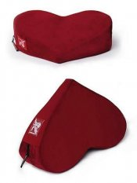
www.goodvibes.com – Good Vibrations (Resource for DVDs, toys, lube, books) Positioning Toys

Slide 39
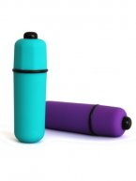
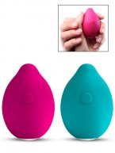
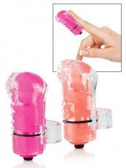
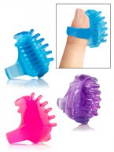
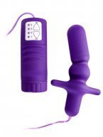
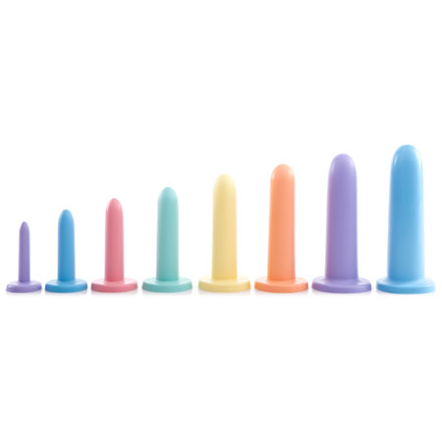
Sex toys www.goodvibes.com – Good Vibrations (Resource for DVDs, toys, lube, books)

Slide 40
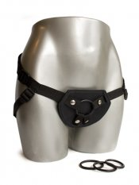
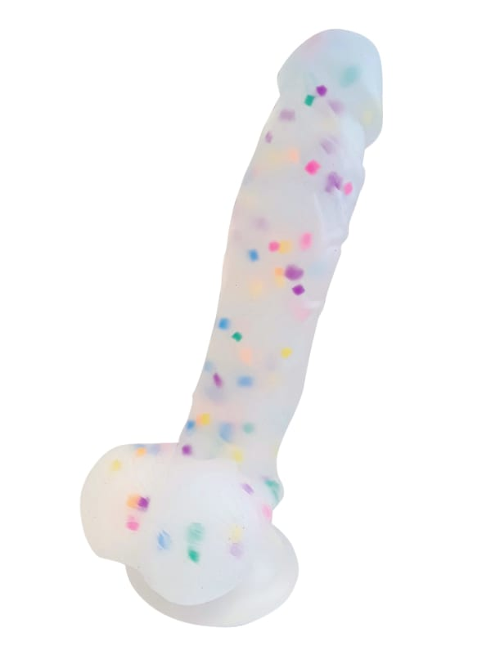
Sex toys www.goodvibes.com – Good Vibrations (Resource for DVDs, toys, lube, books)

Slide 41
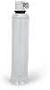
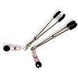
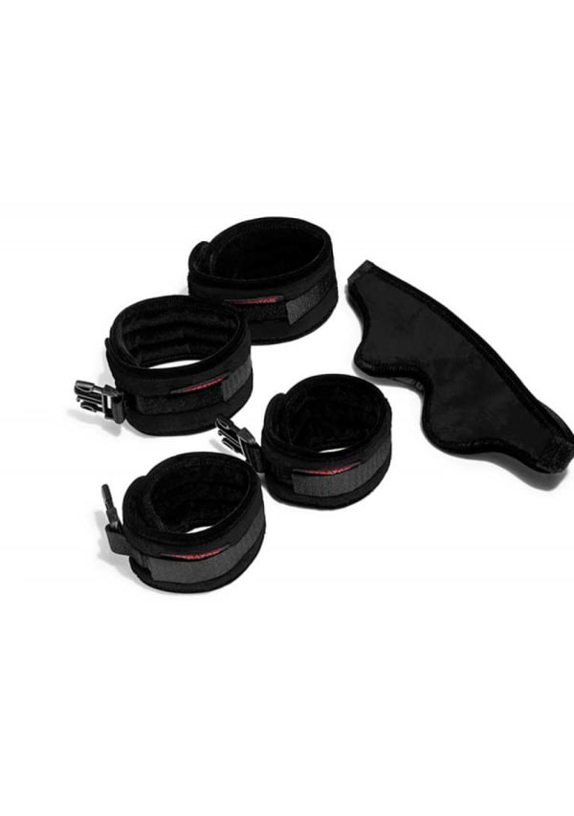
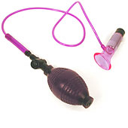
Sensation Toys www.goodvibes.com – Good Vibrations (Resource for DVDs, toys, lube, books)

Slide 42
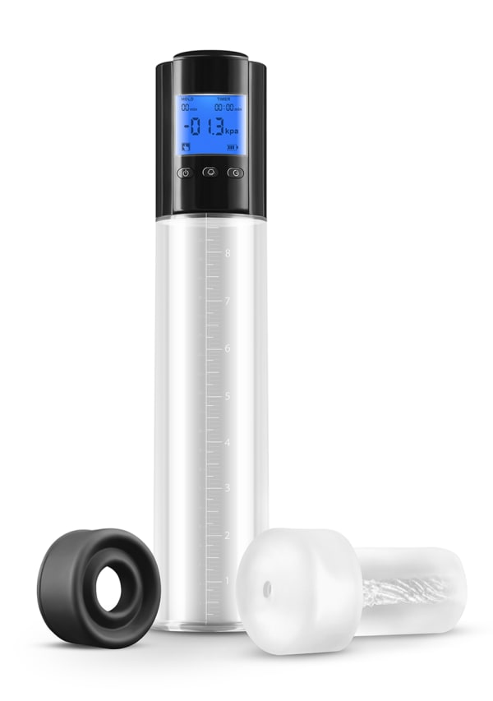
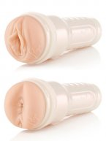
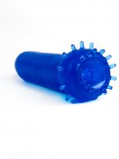
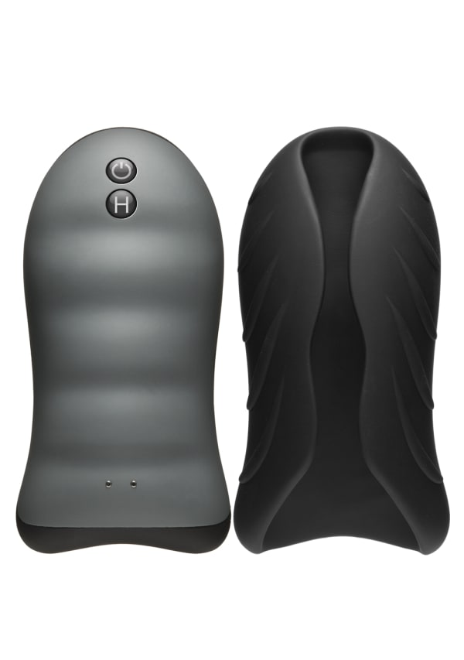
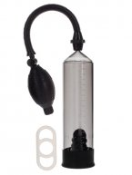
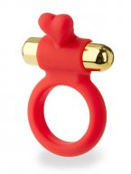
www.goodvibes.com – Good Vibrations (Resource for DVDs, toys, lube, books)

